Slide 1

Rapid Review
CSE 115A Fall 2024
Team Jetskiz:
Product Owner & Dev: Jiemas Rubio
Scrum Master & Dev: Jianwen Wu
Developers: Serene Cheng, Tiffany Guan, and Zachary Venzor
Notes:
Company or organization logo (if applicable)

Slide 2
Rapid Review
Problem: Educational resources are increasingly paywalled
Target audience: Students who can’t pay for study features
Includes these study features in the website
Goal: encourage students to engage in effective study habits without worrying about a subscription
Notes:
We’ve seen a lot of educational applications started paywalling a lot of their features, such as Quizlet, Kahoot!, Grammarly, and so much more. Although some still have a free version available, we wanted to create our version of a studying application with the purpose of allowing students to study more effectively without having to worry about paying to use certain features.
Our application will allow students to not only create their own flashcard sets, but also be able to generate their own randomized tests to inforce understanding the concept of the flashcards rather than memorizing the correct answers word for word.
Brief outline of problem/opportunity
Who will care? Whom will it help? Why?

Slide 3
Project Scope
High Level Goals for Rapid Review:
Be able to perform CRUD operations on sets
Be able to perform CRUD operations on individual flashcards
Be able to generate tests from a set
Utilize an LLM in the test generation
Notes:
Our high level goals are: ^
High level goal(s) (for this project)

Slide 4
Sprint 1
User Stories:
As a student, I want to transfer my notes into flashcards, so I can study in a variety of active ways. [8]
As a student, I want to organize my flashcards into sets, so I can study cards that are relevant to each other. [8]
As a student who uses various study platforms, I want to use flashcards from other places on this website, so I don’t waste time creating sets that already exist. [13]
As a student, I want to know when a card I just wrote is already in the set, so I don’t make unnecessary duplicates. [3]

Slide 5
Sprint 1
Spikes:
Get familiar with new technologies
Researching OpenAI APIs and prompt engineering
Infrastructure tasks:
Set up framework for front end, back end, and database
Install each technology and framework locally for each team member

Slide 6
Sprint 2
User Stories:
As a student, I want to practice answering multiple-choice questions created from my flashcards, so that I can study in an active way. [13]
As a student, I want to practice answering free response questions created from my flashcards, so that I can study in an active way. [5]
As a new site visitor, I want to create an account, so I can create personal flashcard sets. [8]
As a returning site user, I want to log in, so I can see the sets I have created. [5]
As a student, I want to mark specific cards in my set, so I know to focus my study effort on these cards. [3]

Slide 7
Sprint 2
Spikes:
Prototyping LLM output into the test generation
In preparation for next sprint
Infrastructure tasks:
Should be completed in Sprint 1
If not, resume completion in this sprint

Slide 8
Sprint 3
User Stories:
As a student, I want the wrong options in the multiple-choice questions to be relevant to the question, so I study better. [21]
As a student, I want the wording of the correct answer in multiple-choice questions to vary, so I avoid memorizing the answer and focus on understanding it. [8]
As a student, I want to be able to search for specific flashcards within a set, so I can quickly update or find the information I need. [3]
Notes:
This is the sprint where the LLM tie in starts

Slide 9
Sprint 3
Spikes:
Learning OpenAI API
Exploring and finalizing LLM choice
Researching ideal LLM prompts
Notes:
This is the sprint where the LLM tie in starts

Slide 10
Sprint 4
User Stories:
As a student, I want my answers to free response questions to have correct evaluations, so I can focus on remembering concepts rather than memorizing the exact wording of the flashcard. [21]
As a student repeatedly studying the same set through test generation, I want the questions to occasionally have varied phrasing, so I avoid memorizing. [8]
As a student repeatedly studying the same set through test generation, I want the options of multiple choice questions to occasionally have varied phrasing, so I avoid memorizing. [8]

Slide 11
Sprint 4
Spikes:
Continue learning OpenAI API
Finalizing LLM choice (if not done in Sprint 3)
Continue researching ideal LLM prompts

Slide 12
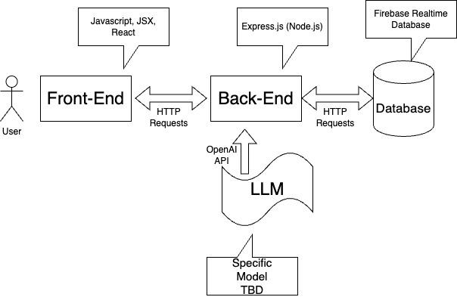
Architecture
Notes:
[Describe, preferably with a diagram, the overall structure/major components of your planned product.]

Slide 13
Technologies
Front end:
React, MUI, Vite
Back end:
Express.js (Node.js), OpenAPI
Database:
Firebase Realtime Database
Testing:
eslint, jest, nodemon, supertest, puppeteer
Notes:
Programming Languages: HTML, Javascript
Front End: React, MUI
Back end: Express.js, Node.js
Server/Database: Firebase
Development environment VS Code
[Technology 1] e.g. programming language(s)
[Technology 2] e.g. web framework
[Technology 3] e.g. development environment
…
(use several slides as necessary)

Slide 14
Challenges/Risks
The entire team is unfamiliar with LLMs, OpenAI API, and prompt engineering
A part of the team is learning many new technologies
Most of the team has never used git collectively before
Scheduling meetings on specific days will be difficult
Notes:
Challenge/Risk 1: OpenAI API (LLM feature), could have limited uses like ChatGPT (all are unfamiliar with this technology)
Challenge/Risk 2: Many of us are learning other new technologies
Challenge/Risk 3: Many of us have never used git as a team before

Slide 15
Minimum Viable Product (MVP)
As a student, I want to transfer my notes into flashcards, so I can study in a variety of active ways.
As a student, I want to organize my flashcards into sets, so I can study cards that are relevant to each other.
As a student who uses various study platforms, I want to use flashcards from other places on this website, so I don’t waste time creating sets that already exist.
As a student, I want to practice answering multiple-choice questions created from my flashcards, so that I can study in an active way.
As a student, I want the wrong options in the multiple-choice questions to be relevant to the question, so I study better.
Notes:
[Describe the product that you need to achieve at a minimum
to call the project a success.
List the user stories that describe the minimum functionality.
]

